Slide 1

Visualisation in R: ggplot2
Open Source Workshop

Slide 2

About me
Tim Haarman
Data Scientist at Data Science Hub
Mainly Python user but ggplot2 fan

Slide 3
About the workshop
Theory
Examples
Exercise

Slide 4
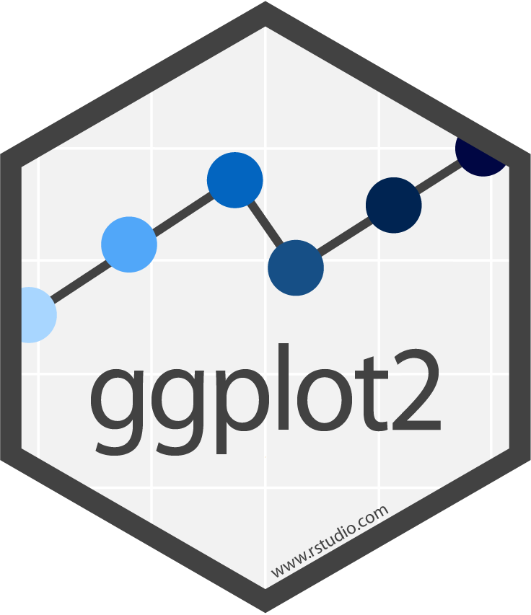
Why ggplot2?

Slide 5
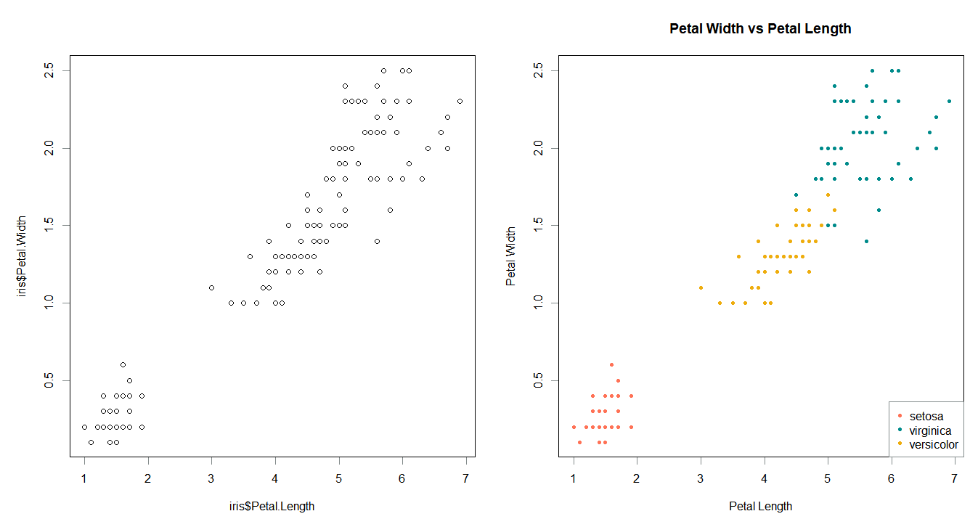
Why not use R’s plotting?
plot(iris$Petal.Length, iris$Petal.Width)

Slide 6
Why not use R’s plotting?
##Plot showing species subsets (right)
plot(iris$Petal.Length, iris$Petal.Width,
xlab = "Petal Length",
ylab = "Petal Width",
main = "Petal Width vs Petal Length",
pch = 20,
col=ifelse(iris$Species == "setosa","coral1",
ifelse(iris$Species == "virginica","cyan4",
ifelse(iris$Species == "versicolor",
"darkgoldenrod2", "grey"))))
##legend
legend("bottomright", c("setosa","virginica", "versicolor"),
col = c("coral1","cyan4", "darkgoldenrod2"), pch=20)

Slide 7
Why not use R’s plotting?
Scatterplot
Lineplot
Barchart
Boxplot

Slide 8
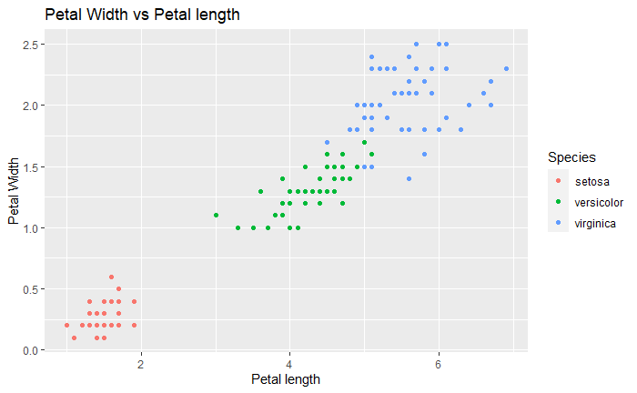
ggplot2’s equivalent
ggplot(iris, aes(x = Petal.Length,
y = Petal.Width,
color = Species)) +
geom_point() +
labs(title = "Petal Width vs Petal length",
x = "Petal length",
y = "Petal Width")

Slide 9
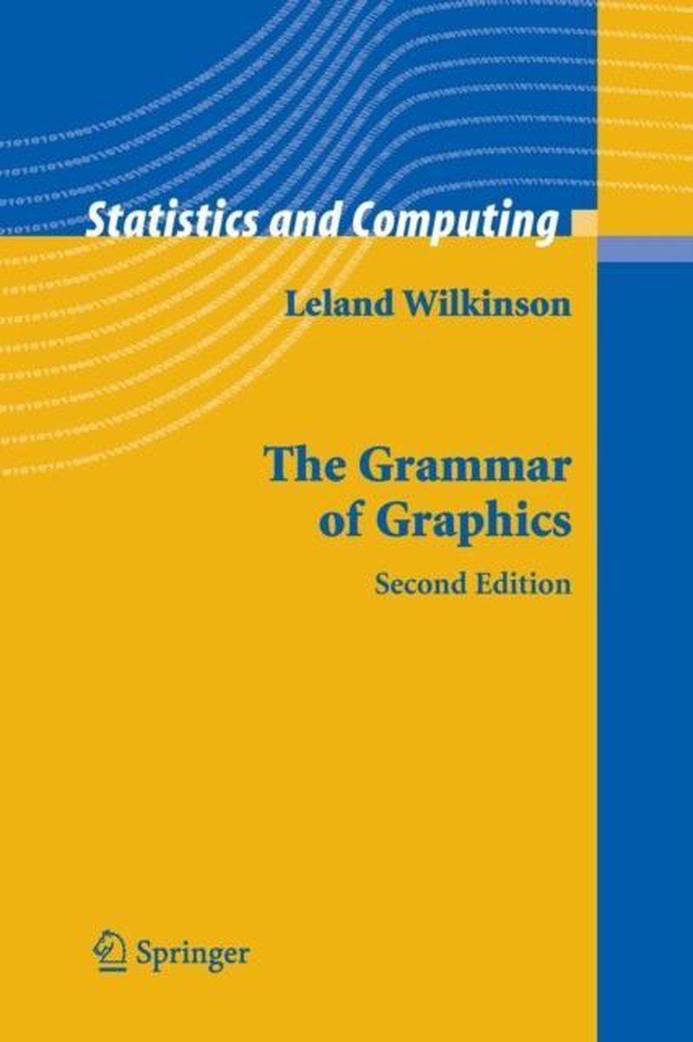
Grammer of Graphics
Book about theoretical (de)construction of data graphics
Foundation of ggplot2

Slide 10
Why ggplot2?
Themes
Modularity
Simple, but very powerful
Coordinates
Facets
Scales
Statistics
Geometries
Mapping
Data

Slide 11
The Layers
Themes
No plots without data
Provided in (tidy) tabular form
Eg.
Coordinates
Facets
Scales
Statistics
Country | Year | GDP p.c. | Population
Brazil | 2019 | 8,711 | 211,000,000
Brazil | 2020 | 8,735 | 212,500,000
Colombia | 2019 | 7,500 | 50,300,000
Colombia | 2020 | 7,600 | 50,600,000
Geometries
Mapping
Data

Slide 12
The Layers
Themes
What data goes where?
Maps variables to graphical properties
x-axis = Column A,
y-axis = Column B,
colour = Column C
Coordinates
Facets
Scales
Statistics
Geometries
Mapping
Data

Slide 13
The Layers
Themes
Type of plot
Histogram
Bar plot
Line plot
Scatterplot
ggplot2 has 31 different ‘geoms’
Coordinates
Facets
Scales
Statistics
Geometries
Mapping
Data

Slide 14
The Layers
Themes
Apply transformations on the data
Counts in a histogram
Median/quartiles in boxplot
Often implicit in ggplot2
Coordinates
Facets
Scales
Statistics
Geometries
Mapping
Data

Slide 15
The Layers
Themes
Translate between data and graphical properties
Categories -> Colour
Numbers -> Position
Etc…
Coordinates
Facets
Scales
Statistics
Geometries
Mapping
Data

Slide 16
The Layers
Themes
Multiple panels
(default = 1)
Allows for multiple plots on subsets of your data
Coordinates
Facets
Scales
Statistics
Geometries
Mapping
Data

Slide 17
The Layers
Themes
Translates all previous information to a coordinates system to draw
Not in scope for this workshop
Coordinates
Facets
Scales
Statistics
Geometries
Mapping
Data

Slide 18
The Layers
Themes
Change how the plots look
Encompases everything not related to the data
Coordinates
Facets
Scales
Statistics
Geometries
Mapping
Data

Slide 19
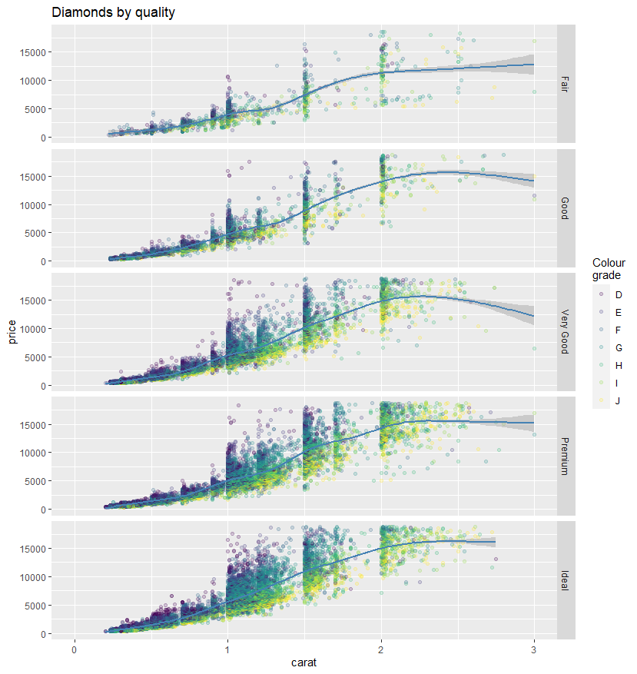
Let’s make some plots

Slide 20
Open Source Workshop: ggplot2
Three layers you always have to define
The others have implicit defaults
Themes
Coordinates
Facets
Scales
Statistics
Geometries
Mapping
Data

Slide 21
Open Source Workshop: ggplot2
> library(ggplot2)
> mpg
# A tibble: 234 x 11
manufacturer model displ year cyl trans drv cty hwy fl class
<chr> <chr> <dbl> <int> <int> <chr> <chr> <int> <int> <chr> <chr>
1 audi a4 1.8 1999 4 auto(l5) f 18 29 p compact
2 audi a4 1.8 1999 4 manual(m5) f 21 29 p compact
3 audi a4 2 2008 4 manual(m6) f 20 31 p compact
4 audi a4 2 2008 4 auto(av) f 21 30 p compact
5 audi a4 2.8 1999 6 auto(l5) f 16 26 p compact
6 audi a4 2.8 1999 6 manual(m5) f 18 26 p compact
7 audi a4 3.1 2008 6 auto(av) f 18 27 p compact
8 audi a4 quattro 1.8 1999 4 manual(m5) 4 18 26 p compact
9 audi a4 quattro 1.8 1999 4 auto(l5) 4 16 25 p compact
10 audi a4 quattro 2 2008 4 manual(m6) 4 20 28 p compact
# ... with 224 more rows

Slide 22

Open Source Workshop: ggplot2
ggplot(data = mpg)

Slide 23
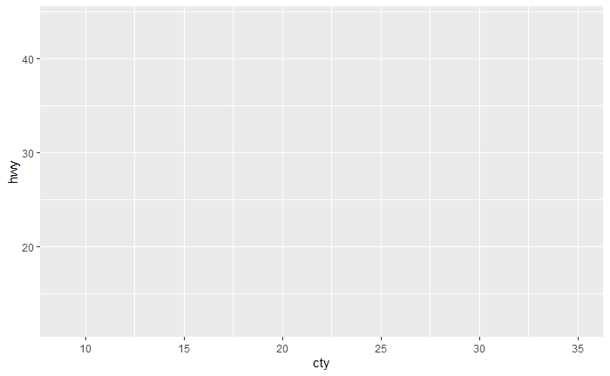
Open Source Workshop: ggplot2
ggplot(data = mpg,
mapping = aes(x = cty, y = hwy))

Slide 24
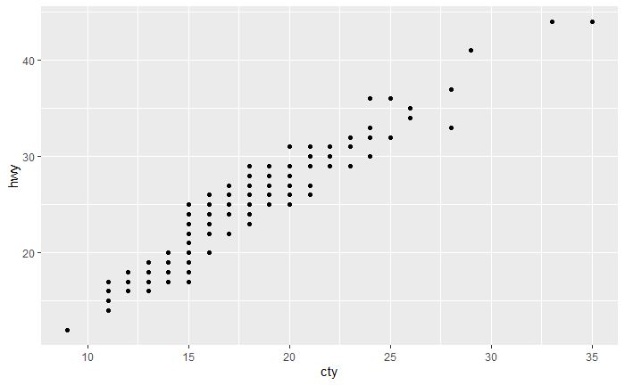
Open Source Workshop: ggplot2
ggplot(data = mpg,
mapping = aes(x = cty, y = hwy)) +
geom_point()

Slide 25
Open Source Workshop: ggplot2
ggplot(data = mpg,
mapping = aes(x = cty, y = hwy)) +
geom_point()
==
ggplot(mpg, aes(cty, hwy)) +
geom_point()

Slide 26
Open Source Workshop: ggplot2
ggplot(mpg, aes(x = cty,
y = hwy)) +
geom_point()

Slide 27
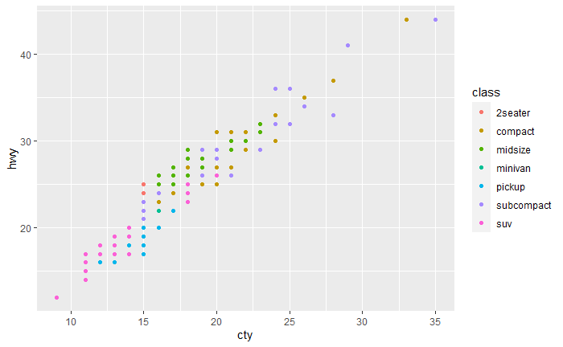
Open Source Workshop: ggplot2
ggplot(mpg, aes(x = cty,
y = hwy,
colour = class)) +
geom_point()

Slide 28
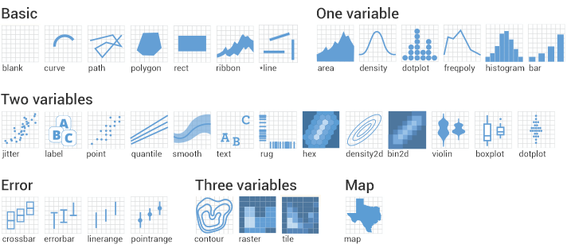
Open Source Workshop: ggplot2

Slide 29
Scales
Themes
Everything in aes() has a scale
x
y
colour
size
etc..
Apply with consistent function:
scale_<aesthetic>_<type>()
E.g. scale_color_continuous(…)
Coordinates
Facets
Scales
Statistics
Geometries
Mapping
Data

Slide 30
Open Source Workshop: ggplot2
ggplot(mpg, aes(x = cty,
y = hwy,
colour = class)) +
geom_point()

Slide 31
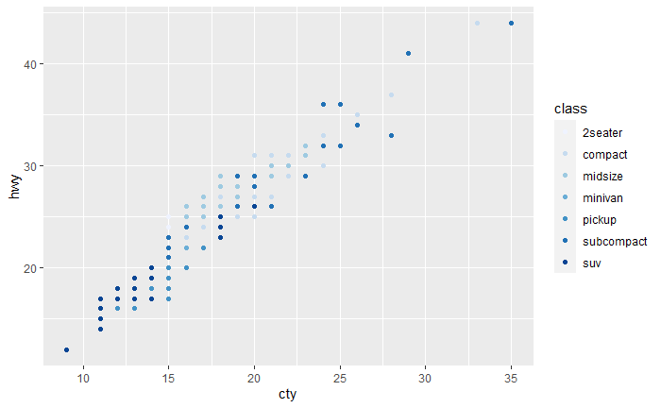
Open Source Workshop: ggplot2
ggplot(mpg, aes(x = cty,
y = hwy,
colour = class)) +
geom_point() +
scale_colour_brewer(type = "seq")

Slide 32
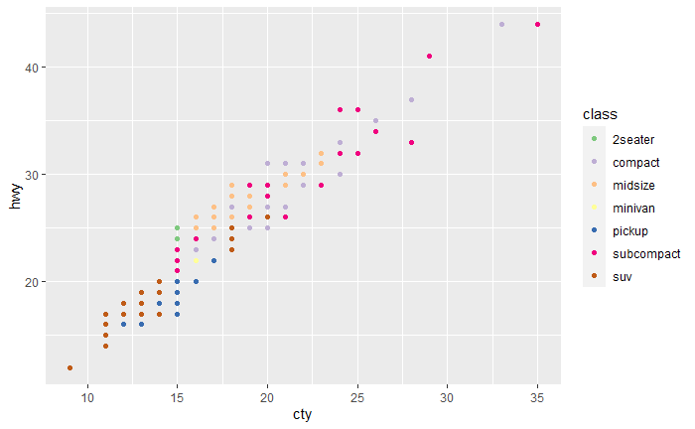
Open Source Workshop: ggplot2
ggplot(mpg, aes(x = cty,
y = hwy,
colour = class)) +
geom_point() +
scale_colour_brewer(palette = "Accent")

Slide 33
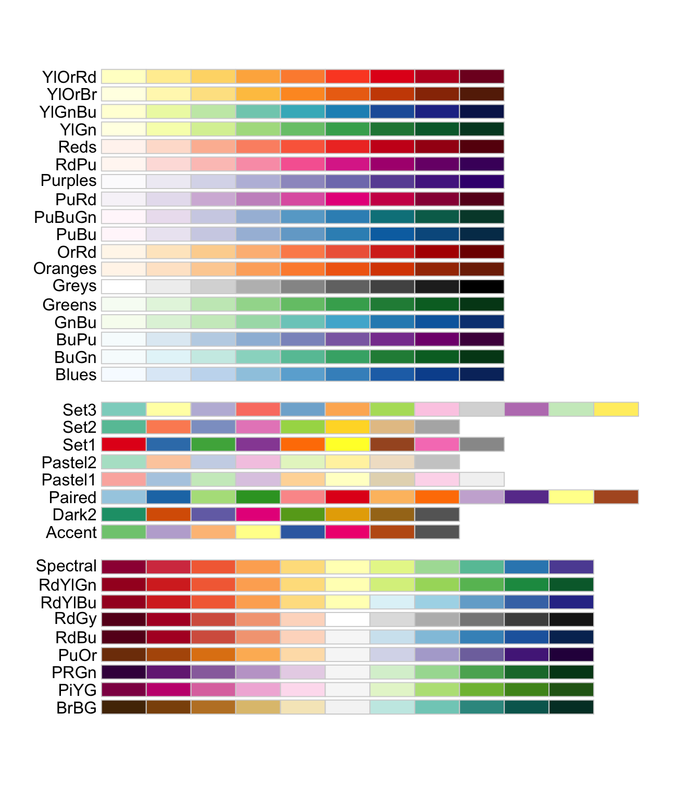
Open Source Workshop: ggplot2

Slide 34
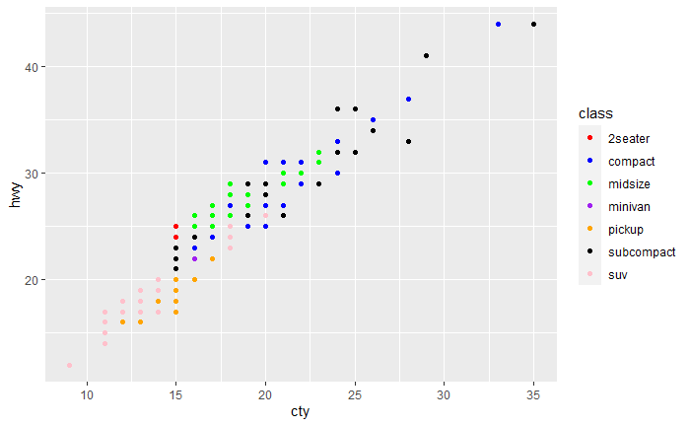
Open Source Workshop: ggplot2
ggplot(mpg, aes(x = cty,
y = hwy,
colour = class)) +
geom_point() +
scale_colour_manual(
values = c("red", "blue", "green", "purple",
"orange", "black", "pink")
)

Slide 35
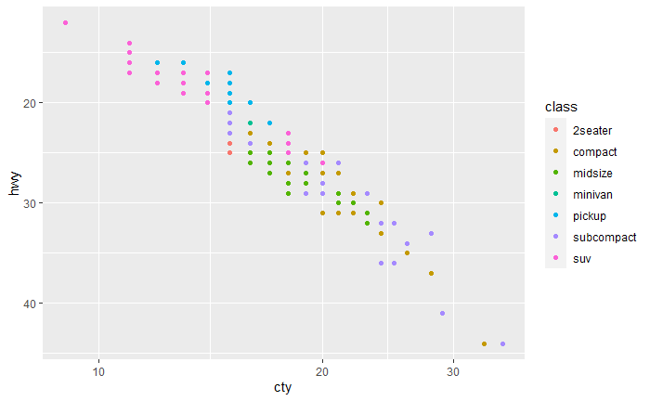
Open Source Workshop: ggplot2
You can also scale the X and Y aesthetic like this!
ggplot(mpg, aes(x = cty,
y = hwy,
colour = class)) +
geom_point() +
scale_x_continuous(trans = "log10") +
scale_y_continuous(trans = "reverse")

Slide 36
The Layers
Themes
Divide your plot into multiple panels with subsets of your data
Coordinates
Facets
Scales
Statistics
Geometries
Mapping
Data

Slide 37
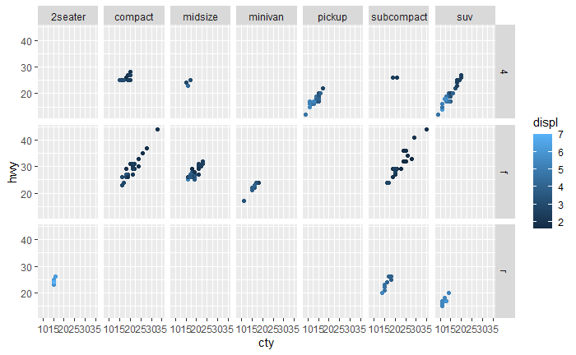
Open Source Workshop: ggplot2
ggplot(mpg, aes(x = cty,
y = hwy,
colour = displ)) +
geom_point() +
facet_grid(drv ~ class)

Slide 38
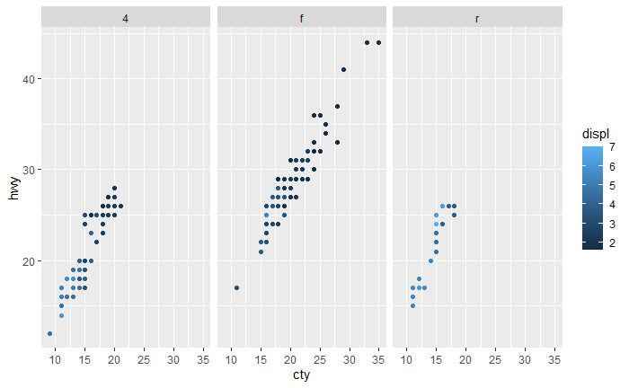
Open Source Workshop: ggplot2
ggplot(mpg, aes(x = cty,
y = hwy,
colour = displ)) +
geom_point() +
facet_grid(cols = vars(drv))

Slide 39
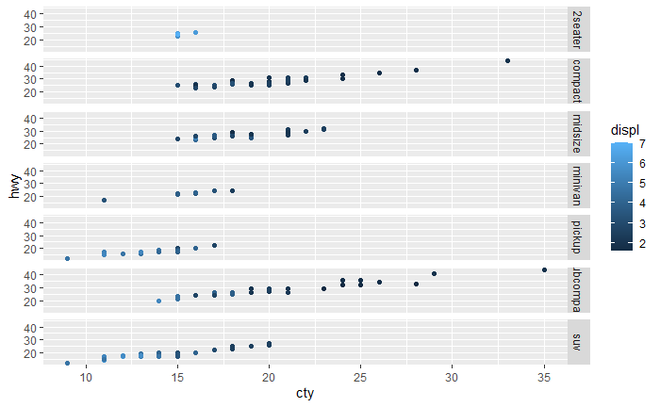
Open Source Workshop: ggplot2
ggplot(mpg, aes(x = cty,
y = hwy,
colour = displ)) +
geom_point() +
facet_grid(rows = vars(class))

Slide 40
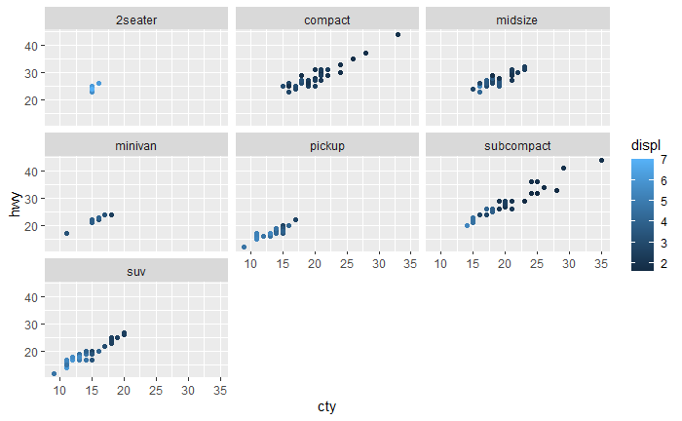
Open Source Workshop: ggplot2
ggplot(mpg, aes(x = cty,
y = hwy,
colour = displ)) +
geom_point() +
facet_wrap(vars(class))

Slide 41
The Layers
Themes
Change how the plots look
Either:
Apply complete themes
Adjust individual components
Coordinates
Facets
Scales
Statistics
Geometries
Mapping
Data

Slide 42
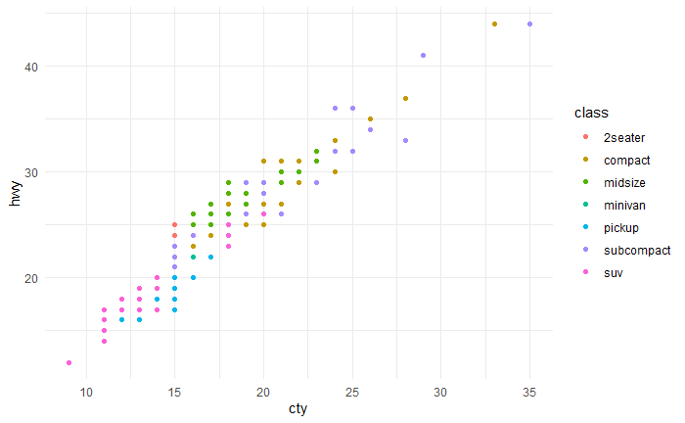
Open Source Workshop: ggplot2
There are some predefined themes
ggplot(mpg, aes(x = cty,
y = hwy,
colour = class)) +
geom_point()
ggplot(mpg, aes(x = cty,
y = hwy,
colour = class)) +
geom_point() +
theme_minimal()

Slide 43
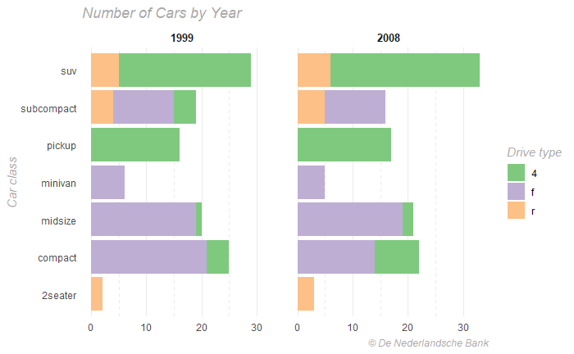
Open Source Workshop: ggplot2
ggplot(mpg) +
geom_bar(aes(y = class, fill = drv)) +
facet_grid(cols = vars(year)) +
scale_fill_brewer(palette = 'Accent') +
labs(title = 'Number of Cars by Year',
caption = '© De Nederlandsche Bank',
x = NULL,
y = 'Car class',
fill = 'Drive type') +
theme_minimal() +
theme(
title = element_text(family = 'sans',
face='italic',
color='darkgray'),
strip.text = element_text(face='bold', size=10),
panel.grid.major.y = element_blank(),
panel.grid.minor.x = element_line(
linetype = 'dashed'
)
)

Slide 44

Excercise: KNMI Weather Data

